Slide 1

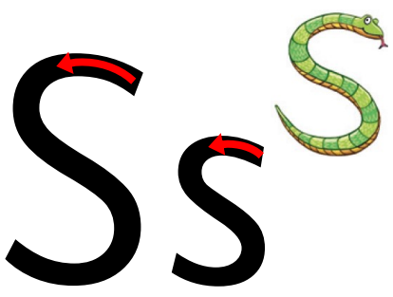
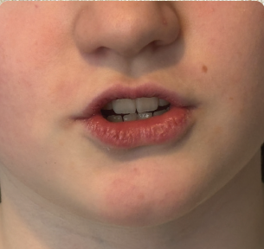
Show your teeth
and let the s hiss
out sssss
Letter formation phrase
Under the snake’s chin, slide down and round its tail.

Slide 2
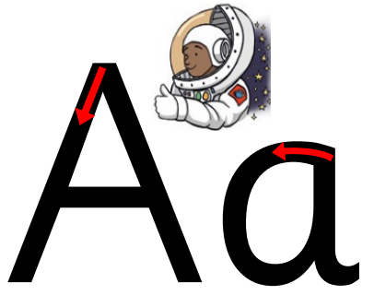
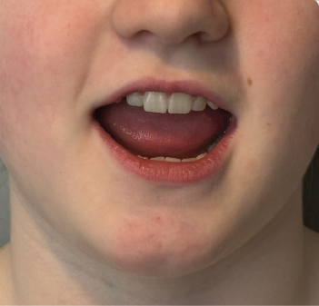
Open your mouth
wide and make
the a sound at
the back of your
mouth a a a
Letter formation phrase
Around the astronaut’s helmet and down into space.

Slide 3
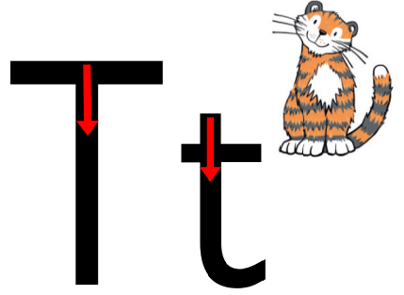
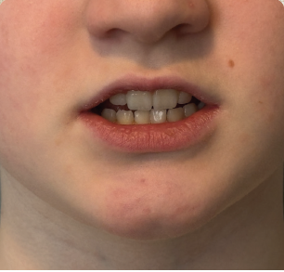
Open your lips;
put the tip of your
tongue behind
your teeth and
press t t t
Letter formation phrase
From the tiger’s nose to its tail, then follow the stripe across the tiger.

Slide 4
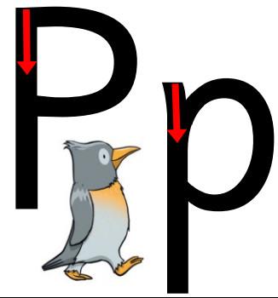
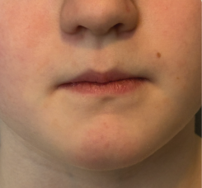
Bring your lips
together, push
them open and
say p p p
Letter formation phrase
Down the penguin’s back, up and around its head.

Slide 5
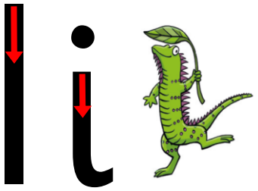
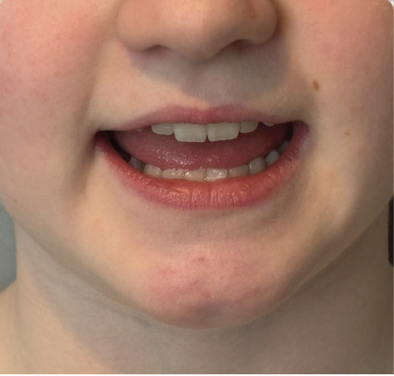
Pull your lips back
and make the i
sound at the back
of your mouth i i i
Letter formation phrase
Down the iguana’s body, then draw a dot (on the leaf) at the top.

Slide 6

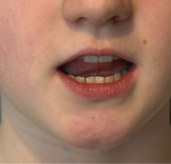
Open your lips
a bit, put your
tongue behind your
teeth and make
the nnnnn sound
nnnnn
Letter formation phrase
Down the stick, up and over the net.

Slide 7
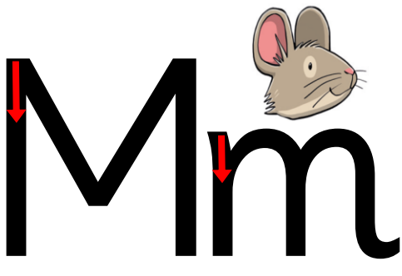
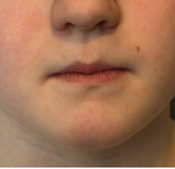
Put your lips
together and make
the mmmmm
sound mmmmm
Letter formation phrase
Down, up and over the mouse’s ears, then add a flick on the nose.

Slide 8
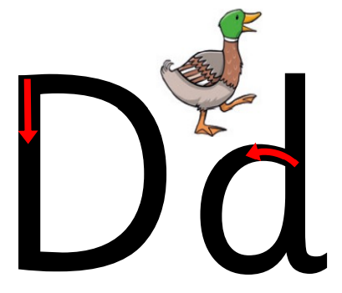
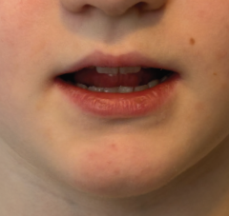
Put your tongue to
the top and front
of your mouth and
make a quick d sound
d d d
Letter formation phrase
Round the duck’s body, up to its head and down to its feet.

Slide 9
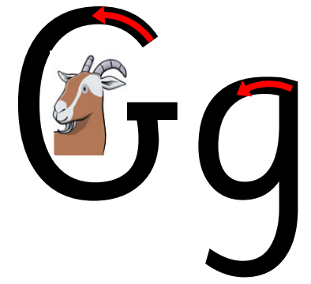
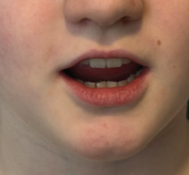
Give me a big smile
that shows your
teeth. Press the
middle of your tongue
to the top and back
of your mouth; push
your tongue down
and forward to make
the sound g g g
Letter formation phrase
Round the goat’s face, up to his ear; down and curl under his chin.

Slide 10
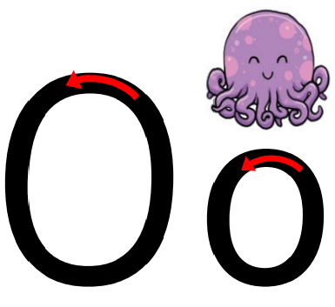
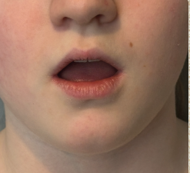
Make your mouth
into a round shape
and say o o o
Letter formation phrase
All around the octopus.

Slide 11
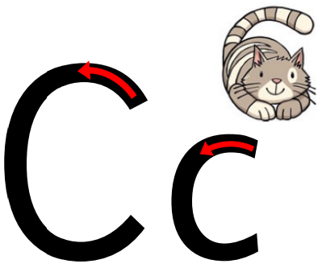
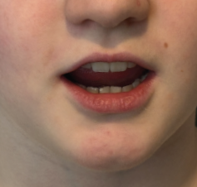
Open your mouth
into a little smile;
make your tongue
flat and move it up
towards the top of
your mouth to say
c c c
Letter formation phrase
Curl around the cat.

Slide 12

Open your mouth
into a little smile;
make your tongue
flat and move it up
towards the top of
your mouth to say
Letter formation phrase
Down the kite, up and round, down to the corner.

Slide 13

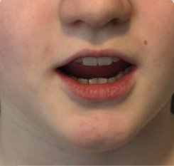
ck
Open your
mouth into a
little smile; make
your tongue flat
and move it up
towards the top
of your mouth
to say c c c
Letter formation phrase
Curl around the cat.
Down the kite, up and round, down to the corner.

Slide 14
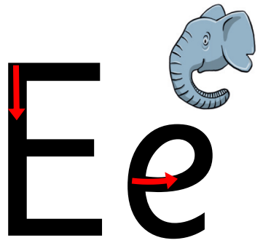
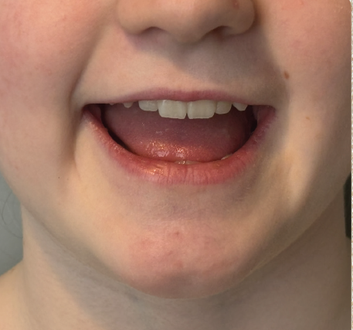
Open your
mouth wide
and say e e e
Letter formation phrase
Around the elephant’s eye and down its trunk.

Slide 15
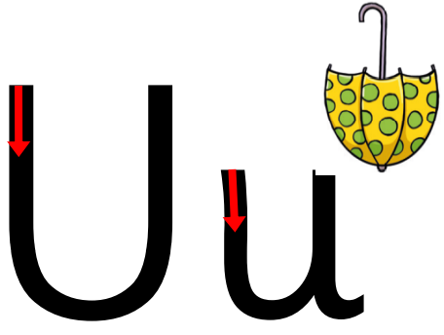
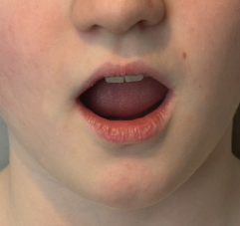
Open your
mouth wide and
say u u u
Letter formation phrase
Down and around the umbrella, stop at the top and down to the bottom and flick.

Slide 16
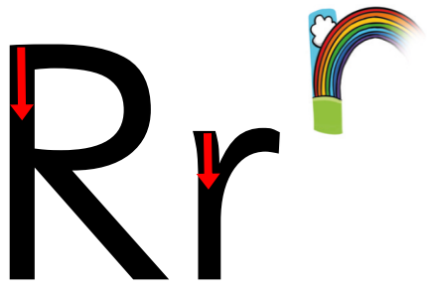
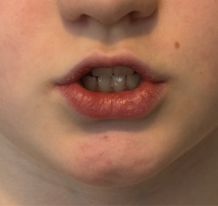
Show me your
teeth to make
a rrrrr sound
rrrrr
Letter formation phrase
From the cloud to the ground, up the arch and over the rainbow.

Slide 17
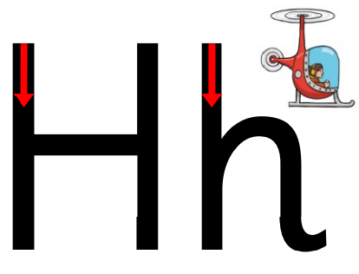
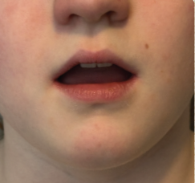
Open your
mouth and
breathe out
sharply h h h
Letter formation phrase
Down, up and over the helicopter.

Slide 18
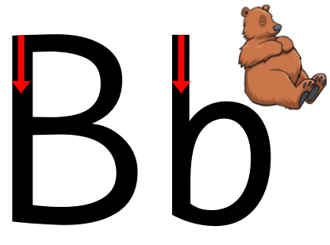
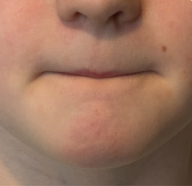
Put your lips
together and
say b as you
open them
b b b
Letter formation phrase
Down bear’s back, up and round his big tummy.

Slide 19
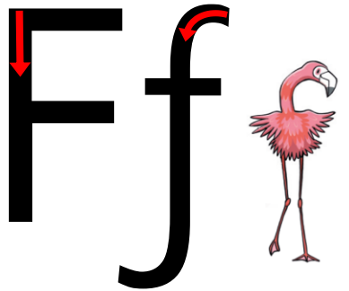
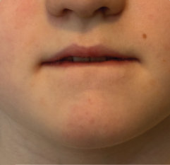
Open your lips
a little, put
your teeth on
your bottom lip
and push the
air out to make
the sound fffff
Letter formation phrase
Down the flamingo’s neck, all the way to its foot, then across its wings.

Slide 20
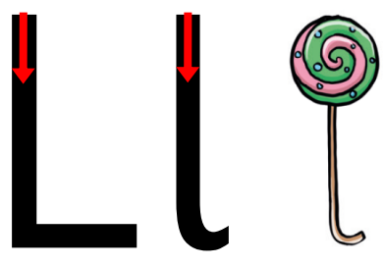
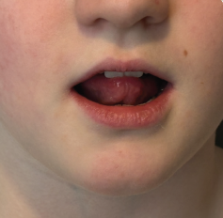
Open your
mouth a little,
put your tongue
up to the top
of your mouth
behind your
teeth and press
llll llll
Letter formation phrase
All the way down the lollipop.

